Slide 1
Quant Hack Night #3
2/2/2022

Slide 2
Agenda
Attendance Form + Brain Teasers
Prices Indicate Buyer/Seller Views
Order Matching
Market Making
Games! (More will be played next week)

Slide 3
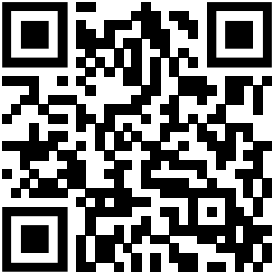
Attendance Slide

Slide 4
Brain Teaser Question 1 part 1
1000!
What is the last digit of this expression and why?

Slide 5
Brain Teaser Question 1 part 2
1000!
How many trailing zeros are in this expression (example 5! = 240 and has 1)

Slide 6
Brain Teaser Question 1 part 3
1000!
How many trailing zeros are in this expression if it were in base 25

Slide 7
Brain Teaser Question 2 part 1
We roll a 6 sided die until we get a 5 and a 6 (not necessarily one after another). What is the expected number of rolls?

Slide 8
Brain Teaser Question 2 part 2
We roll a fair 6-sided die twice. What is the probability that the first roll was a 4 given that the second roll was greater than the first?

Slide 9
Prices for Buyers and Sellers
Buyer
Has some form of money (cash for example) and would like to trade this in for another type of good (a share of stock for example)
What factors affect whether or not buyer A will buy a specific good?
Price of the good
Valuation of the good according to buyer A’s needs
If Valuation(Good) > Price, Buyer A should buy
What if Valuation(Good) = Price?

Slide 10
Prices for Buyers and Sellers (cont.)
Seller
Has some type of good (a share of stock for example) and would like to trade this in for some money (cash for example)
What factors affect whether or not seller B will sell a specific good?
Price of the good
Valuation of the good according to seller B’s needs
If Valuation(Good) < Price, Seller B should sell
What if Valuation(Good) = Price?

Slide 11


Price Movements
Let's consider an analogy with buying a new video game . . .
$500
$600
$550
$525
$700
$830

Slide 12
Price Movements
Let's Say that Person 3 Buys the Playstation for $500 and it is now sold out
$500
$600
$550
$525
$700
$830

Slide 13
Price Movements
Playstation can now increase its prices…
$600
X
X
$600
$550
$525
$700
$830

Slide 14
Price Movements
$650
$600
$550
$525
$700
$830

Slide 15
Order Matching System
System used by brokerages to match buy and sell orders together
Core of all electronic exchanges
Lots of quant firms may ask coding questions related to building your own order matching system (Ex: IMC Trading)
Two states
Continuous System
Orders matched immediately
Auction State
Matching is done at fixed intervals
When the market opens for the day and a number of orders builds up
May use a priority queue and priority stack

Slide 16
Order Book Example
Bid (Volume) | Price | Ask (Volume)
 | 100.03 | 150
 | 100.02 | 100
 | 100.01 | 50
 | 100
60 | 99.99
120 | 99.98
180 | 99.97

Slide 17
Order Book Example continued
Bid (Volume) | Price | Ask (Volume)
 | 100.03 | 150
 | 100.02 | 100 (SOLD)
 | 100.01 | 50 (SOLD)
 | 100
60 | 99.99
120 | 99.98
180 | 99.97

Slide 18
Order Book Example continued
Bid (Volume) | Price | Ask (Volume)
 | 100.05 | 150
 | 100.04 | 100
 | 100.03 | 50
 | 100.02
60 | 100.01
120 | 100
180 | 99.99

Slide 19
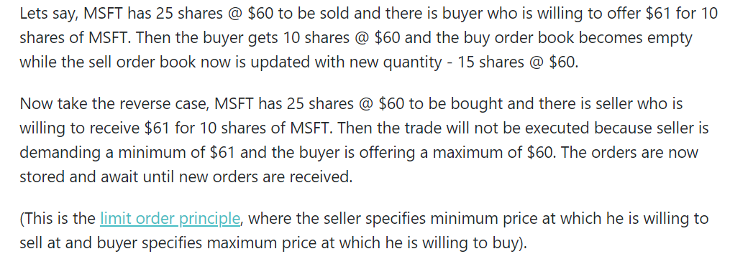
Ex: Order Matching

Slide 20
Making a Market
We can “make a market” to reflect our sentiment about how much we value a certain product.
Includes a lower and an upper bound, or a range in which we believe the value of the product lies inside.
Person A is willing to buy a share of AAPL at $100 and sell it at $105
What does this imply?
Person A’s market is 100 @ 105.

Slide 21
Making Trades in the Market
Everyone who trades in the financial market has this upper and lower bound!
So when does a trade between 2 people occur?
Person A wants to buy something at a price $X. If someone wants to sell to Person A at price $X, there will be a trade.
Person A’s market on apple is 100 @ 105.
Person B’s market on AAPL is 102 @ 106.
Person C’s market on AAPL is 98 @ 105.
Person D’s market on AAPL is 90 @ 95.
Person E’s market on AAPL is 105 @ 110.
In the above scenario who will trade with A?
Person A will trade with D and E.

Slide 22
Market Making Game!
Get into groups of (3 or 4?)
Once you have a group we will begin
We will roll a 10 sided dice 5 times and make a market around the total sum of the rolls
Each person in your group will take turns being the market maker. They will provide a range (ex. 24 @ 30) and everyone else in the group will be able to trade with them. You can either buy or sell 1 share to the market maker.
Keep track of how many shares each person has in a google doc/spreadsheet.
Make a market on the sum of the numbers given to your group.

Slide 23
Market Making Game
How many countries in the world have over 50 million people?

